Slide 1
Food-Stat
Personalized Food Scoring & Recommendation System for Diverse Lifestyles

Slide 2
Our team
Shivesh Kumar Dhiman
Vikas Kumar
Saumil Kulshreshtha
Shubh Pundir

Slide 3
Table of contents
01
02
04
05
03
Problem Statement
Solutions
Technology Stack
06
Flow Diagram
Impact & Benefits
Conclusion

Slide 4
01
Problem Statement

Slide 5
False Advertising/Marketing
Consumers are often misled by false advertising, such as exaggerated health claims and deceptive labels on packaged foods. These marketing tactics create a false sense of nutritional value, making it difficult to identify truly healthy options and increasing the need for transparency and accurate, fact-based food evaluation.

Slide 6
Informed Choices
Consumers face challenges in making educated decisions regarding packaged food due to the overwhelming options available and inconsistent food labeling. This complexity can lead to confusion, making it difficult for individuals to select food that aligns with their health goals.

Slide 7
Nutritional Needs
Different demographics such as gym-goers, regular lifestyle maintainers, infants, and pregnant women possess unique nutritional requirements. Current solutions often fail to address these varying needs, leaving specific user groups without tailored dietary guidance.

Slide 8
Lack of Personalization
The absence of real-time, personalized food scoring systems hampers consumers' abilities to identify foods that fit their individual health metrics and dietary preferences. Existing applications generally lack the capability to provide customized recommendations based on one's lifestyle.

Slide 9
02
Solutions

Slide 10






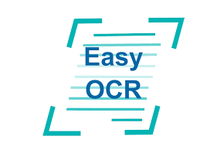
Barcode Scanner
Dietary Plan
Integration
Lifestyle-Based Recommendations
Health & Ingredient-Based Ratings
Personalized balanced diet plans
Tailor recommendations for gym goers, maintenance, infants and pregnant mothers
Custom Machine Learning Algorithms to assign food ratings
Barcode Scanner to get nutritional content
AI-Driven Food Compatibility Score
Custom Food Filters
Real-time Food Label Scanning
Implement a ML framework based on Age, Sex, Height, Weight, Dietary preferences
Create custom food filters based on allergies, preferences, or intolerances
Scan nutrition labels and ingredients using EasyOCR

Slide 11
03
Technology Stack

Slide 12


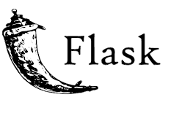



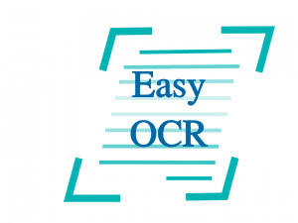
Frontend
Database
Backend
Jinja
MongoDB
Used Flask for Backend Development
Easy OCR
Atlas
PyTorch
TensorFlow
Used for capturing Label Data
Cloud Data
Used For Model Development

Slide 13
Flow Diagram
04

Slide 14
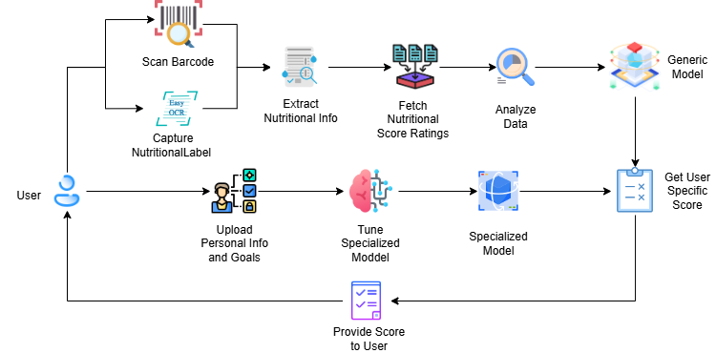

Slide 15
05
Impact & Benfits

Slide 16



Convenience
Better Food Quality & Ingredient Transparency
Wide Audience with Diverse Lifestyle
Gym-goers, maintenance, infants, and pregnant mothers with specialized recommendations and scores.
Users can instantly evaluate food items while shopping, making it easier to choose healthier alternatives on the go
Highlights ingredient quality and health impact, pushing users toward foods with cleaner, safer ingredients.

Slide 17

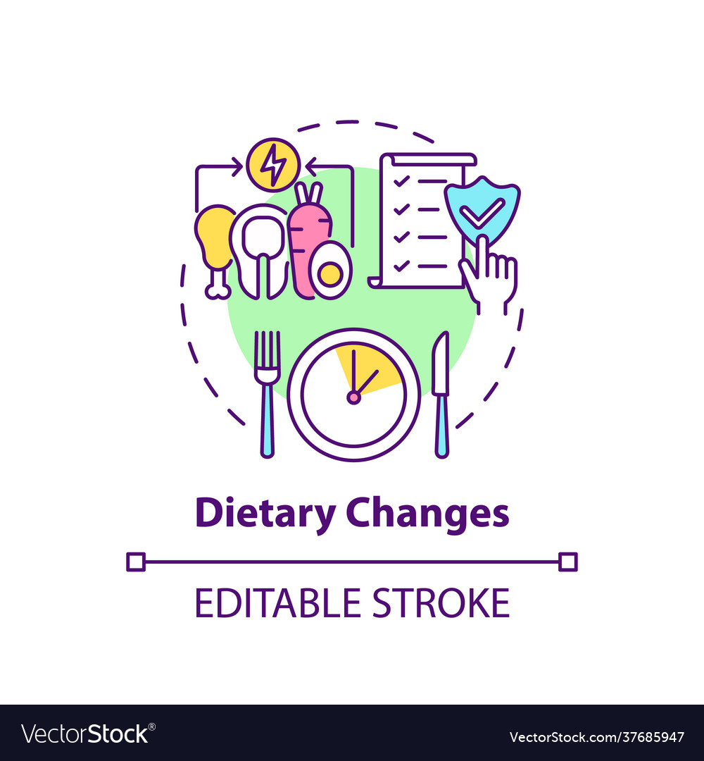

User Awareness
Improved Diet & Fitness Outcomes
Integration with Wearable Devices
Assists users in staying on track with their fitness goals (muscle gain, weight loss, etc.) by recommending foods and creating personalized diet plans.
Integration with smartwatches and fitness brands to personalize and dynamically track the progress of the user
Increased dietary awareness and trust the food they consume

Slide 18
Health Outcomes
By encouraging awareness and informed decisions, the system aims to improve users' diet and fitness outcomes. Personalized recommendations and insights assist individuals in achieving their health goals, such as weight loss or muscle gain, by optimizing their food intake.

Slide 19
Conclusion
06

Slide 20
Conclusion:
Food-Stat bridges the gap between misleading food marketing and informed dietary choices by delivering transparent, personalized, and real-time food evaluations. By combining AI-powered analysis with user-specific health and lifestyle data, it empowers individuals to make smarter food decisions—promoting healthier living, better fitness outcomes, and long-term wellness.

Slide 21
Thank You!
Do you have any questions?

